Slide 1

SAMSUNG PRISM
Generative AI
Hackathon
3rd Edition 2026 – 27
Theme ID - 04 · Streaming Live RAG
Team Name - Coding Agent RIT
College Name - M S Ramaiah Institute of Technology, Bengaluru
Member Name & Email 1- Cheshta Rajput (Presenter)
Member Name & Email 2-
Member Name & Email 3-
Member Name & Email 4-
Submission Github link - github.com/cheshtarajput098-arch/kairos
KAIROS Streaming Live RAG that answers while you speak
Speculative retrieval · multi-intent decomposition · in-place state evolution · 100% offline on a laptop CPU
Notes:
Good morning judges. We are Team Coding Agent RIT. Today we present Kairos — an event-driven live streaming RAG engine that eliminates the awkward conversational silence of voice assistants by answering while you speak.

Slide 2
Theme
THEME 04
02 / 12
Voice assistants should answer while you are still speaking, not seconds after you stop
1
Answer while you speak
THEME 04
Speculatively retrieve and draft verified answers from speech prefixes, before the speaker stops talking.
Streaming Live RAG
2
Understand compound questions
Split one utterance into parallel intents instead of one noisy vector search.
Build a retrieval-augmented voice assistant that works on a live speech stream: retrieve and ground answers during the utterance, handle compound questions, and adapt when the speaker changes their mind.
3
Evolve, don't restart
Patch only the claim a late correction affects; keep every other claim byte-identical.
Our entry: KAIROS, an event-driven streaming RAG engine that runs fully offline on CPU.
4
Stay grounded and private
Every claim maps to a verbatim source span; the whole pipeline runs locally with zero network.
Notes:
Theme 04 asks for streaming live RAG. Good morning judges. We are Team Coding Agent RIT. Today we present Kairos — an event-driven live streaming RAG engine that eliminates the awkward conversational silence of voice assistants by answering while you speak.

Slide 3
Existing Solutions & Gaps
PROBLEM STATEMENT
03 / 12
Conventional voice RAG is sequential: nothing starts until the speaker has finished
HOW EXISTING VOICE ASSISTANTS WORK
Listen until silence
ASR transcript
Retrieve
LLM generates
3.7 s p50
3.5 – 5.0 s
Fails
100% waste
Awkward silence
On compound questions
On detail revisions
Sequential batch processing (listen → ASR → retrieve → LLM) leaves users waiting in complete silence after they speak.
“I need a venue in Pune for 40 people, and what's the refund policy?” is sent as one noisy vector search.
Late self-repairs (“Actually, make that 60 people”) force naive engines to discard state and re-run the whole turn.
KAIROS: moves retrieval and answer drafting into the utterance window, so the answer is verified the moment speech stops.
Notes:
When you speak to standard voice assistants, they wait until you finish talking, take several seconds to search, and then respond. If you ask two questions at once or correct yourself, they stumble. Voice interaction demands real-time intelligence.

Slide 4
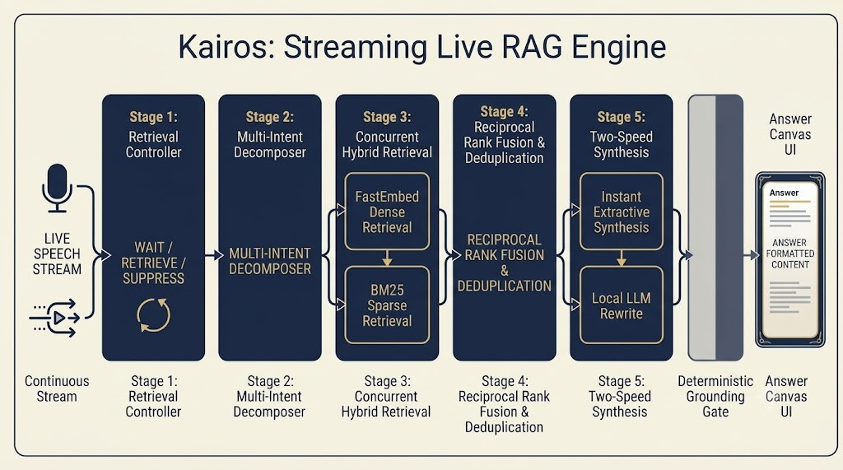
Our Solutions & Architecture Diagram
SYSTEM ARCHITECTURE
04 / 12
A parsimonious 5-stage pipeline on one asyncio event loop, with no LangChain or LlamaIndex
1
Streaming controller
WAIT / RETRIEVE / SUPPRESS per speech chunk in under 1 ms
2
Multi-intent decomposer
Strips disfluencies, splits into ≤ 4 parallel legs
3
Hybrid retrieval
BGE-small dense + BM25 sparse, 400 ms deadline
4
Rank fusion
Reciprocal Rank Fusion (k = 60) + dedup
5
Two-speed synthesis
< 1 ms extractive, then < 820 ms grounded rewrite behind gate G4
Notes:
Our architecture follows strict architectural parsimony: one asyncio event loop, five stages, zero framework bloat. Every stage has a justified microsecond budget. Stage 1 monitors linguistic stability. It knows when enough information has arrived to begin searching, while suppressing searches when users merely ask to change format.

Slide 5
Demo & Product Walkthrough
DEMO SCENARIO 2 · BUSINESS TRAVEL EXPENSE POLICY (DOC_05)
05 / 12
One conversation, three turns: decompose, evolve in place, restructure without searching
TURN 1
RETRIEVE ×2
TURN 2
PATCH 1 claim
TURN 3
0 searches
Compound query
Late refinement
Presentation restructure
“What is the filing deadline for domestic travel expenses, and what currency rate applies?”
“Actually, what if the trip was international?”
“Show that as bullet points.”
Decomposed into Leg A (deadline) and Leg B (currency); both retrieved and answered concurrently.
Patches only Claim 2 (currency). Claim 1 (deadline) stays byte-identical; gate G5 passes.
Controller emits SUPPRESS: zero search calls, the answer is reformatted in memory.
PRODUCT WALKTHROUGH · CALM PRECISION UI
Board 6: Ask / Home
Board 7: Live Conversation
Board 8: Knowledge Explorer
Board 9: Telemetry & Traces
Mic orb + 3 guided scenario cards for one-click replay
Colour-threaded intents, verified-sentence counter, quote drawer
Chunk inspector with BGE + BM25 scores, SHA-256 manifest
Live Gantt of speech chunks, decisions and retrieval legs
Notes:
Here you see our Session Delta Engine in action: when a user clarifies that their trip was international, Kairos refines only the currency claim while preserving the filing deadline strictly untouched. Our Calm Precision design system delivers two modes: a calm consumer voice assistant with quote highlights, and an inspector mode that exposes the live Gantt timeline for judges.

Slide 6
Tools and tech stack used
TECH STACK
06 / 12
Everything runs locally: open models, no cloud APIs, no agent frameworks
1
2
3
4
Speech → text stream
Dense retrieval
Sparse retrieval
Local LLM
Chunked streaming input with prefix-hash caching per chunk
FastEmbed · BGE-small embeddings
BM25s index, fused via Reciprocal Rank Fusion (k = 60)
Qwen2.5-1.5B-Instruct Q4_K_M GGUF (Apache 2.0) via llama-cpp-python
5
6
7
8
Orchestration
Observability
Packaging & eval
Security & UI
Python asyncio, single event loop; no LangChain, no LlamaIndex
OpenTelemetry spans with microsecond per-stage timings
Docker Compose offline container; make eval runs gates G1–G6
STRIDE, OWASP GenAI Top 10, spotlighting, PII redaction · WCAG 2.2 AA UI
Target hardware: laptop-class CPU, 2.0 vCPU and a 4 GB RAM budget
Notes:
Speed 2 rewrites achieve a perfect 5.0 out of 5.0 blind fluency score — an improvement of 1.08 points over raw quotes — while running in just 820ms on CPU.

Slide 7
Impact & Use case
IMPACT
07 / 12
Natural, zero-pause conversation over private documents, on hardware people already own
WHERE IT FITS
1.508 s
saved per turn (median)
1
Enterprise policy assistant
vs the sequential baseline; 100% of retrieval turns saved time
Employees ask about travel, expense and HR rules and get cited answers mid-sentence (demo scenario 2).
2
Booking and service concierge
0 / 112
hallucinated claims
Compound requests like venue + headcount + refund policy, with corrections handled in place.
every claim maps byte-for-byte to a source span (gate G4)
3
Privacy-sensitive on-device voice
No network, PII masked at the stream boundary: suits phones, cars and regulated workplaces.
584 MB
RAM for one session
4
Contact-centre agent assist
fully offline on CPU; 10 concurrent sessions fit in 1.5 GB
Grounded snippets surface while the caller is still talking, with sources shown for trust.
Notes:
Compared to the sequential batch baseline on a shared virtual clock, Kairos saves a median 1.508 seconds per turn. Users experience zero waiting time. Under stress testing, 10 concurrent streaming sessions run at zero error rate using only 1.5 GB of RAM — well within the 4 GB limit of a standard laptop.

Slide 8
Innovation highlights, results and limitations
RESULTS · 64-TURN FROZEN TEST SPLIT
08 / 12
All six acceptance gates pass; here is what works, and what does not yet
Gate | Metric | Threshold | Measured (n) | Status
G1 | Offline reproducibility | 1.0 | 1.0 (zero network) | PASS
G2 | Early retrieval triggering | ≥ 0.80 | 1.000 (n=52) | PASS
G3 | Multi-intent decomposition | ≥ 0.70 | 0.895 (n=19) | PASS
G4 | Grounding (hallucinations) | ≤ 0.00 | 0.0000 (n=112) | PASS
G5 | Selective state continuity | 1.0 | 1.000 (n=18) | PASS
G6 | Telemetry schema | 1.0 | 1.000 (n=64) | PASS
Limitations (honest view)
• At natural 1.0× speech rate, 18 of 52 retrieval turns (34.6%) are not yet fully drafted when speech ends.
• At 10 concurrent sessions p50 latency rises to 8.5 s; at 25 the engine load-sheds.
• A 1.5B local model limits multi-step reasoning depth in rewrites.
• Fluency study is small (n = 20 turns, κ = 0.689); eval uses a single frozen corpus.
Innovation highlights
Ready-at-end drafting (65.4% of turns verified the moment speech ends) · two-speed grounded synthesis · in-place delta evolution of claims
Notes:
All six official hackathon acceptance gates pass with flying colors. Most importantly, Gate G4 achieved exactly 0 fabricated citations across all 112 evaluated claims. Limitations: ready-at-end is 65.4% at normal speech rate, and throughput degrades past 10 concurrent sessions.

Slide 9
What’s next
ROADMAP
09 / 12
Planned next steps, building on the limitations we measured
NEXT
THEN
LATER
Close the ready-at-end gap
Scale and harden
Go on-device and multilingual
• Better prefix-stability prediction to lift 65.4% at 1.0× speech
• Streaming TTS so the spoken reply starts at 0 ms
• Larger, multi-corpus evaluation set
• Batched embedding and shared caches to go past 10 concurrent sessions
• Continuous red-teaming in CI
• Human fluency study with more raters
• Indian-language speech (Hindi, Kannada and more) with code-mixed queries
• NPU-accelerated inference on phones and TVs
• Personal-document RAG that never leaves the device
Notes:
Roadmap: first close the ready-at-end gap at natural speech rate, then scale concurrency, then take Kairos on-device and multilingual.

Slide 10
Brownie points slide( differentiation)
DIFFERENTIATION
10 / 12
Metrics that set KAIROS apart from turn-taking voice RAG
65.4%
1,800 ms
0.0 ms
Ready at end of speech
Median lead time
Time to first token
34 / 52 turns verified the exact millisecond speech ended; 100% at 0.75× and 1.5×
Answers retrieved and verified 1.8 s before the speaker goes silent
p50 TTFT, because the answer is pre-drafted in memory
0.0%
5.0 / 5
0
Attack success rate
Blind fluency score
Agent frameworks
0 / 32 red-team injection turns succeeded under corpus spotlighting
Grounded rewrite vs 3.92 for raw quotes (+1.08), 0% hallucination
One asyncio loop and 5 stages; 0.01 ms security overhead per turn
Notes:
These are the metrics that define Kairos: 65.4% of answers ready at the exact millisecond speech stops, hiding 100% of retrieval latency with a median lead time of 1.8 seconds. Security was built into the edges from day one. Across 32 red-team attack vectors, our attack success rate is 0.0%, with full PII redaction and negligible 0.01ms overhead.

Slide 11
Checklist- Updated on Public GitHub
SUBMISSION CHECKLIST
11 / 12
Release tag PRISM_GENAI_HACKATHON_Y2026 on github.com/cheshtarajput098-arch/kairos
Y
Working prototype code: public or shared GitHub repo
github.com/cheshtarajput098-arch/kairos
Y
README with reproducible setup instructions
docker compose up brings the system up; make eval re-runs gates G1–G6 offline
?
Demo video, max 5 minutes (YouTube or Drive link)
Link: add before submitting
Y
Presentation file (PPT or PDF)
This deck, plus architecture brief, telemetry schema, runbook and STRIDE threat model
Notes:
Kairos proves that streaming live RAG can answer while you speak, eliminate hallucinations deterministically, and run 100% offline on a laptop CPU. Thank you, and we welcome your questions.

Slide 12
Thank you
KAIROS · Team Coding Agent RIT · M S Ramaiah Institute of Technology
Presenter: Cheshta Rajput · github.com/cheshtarajput098-arch/kairos · We welcome your questions
Submitted on: 29 September 2026
Organised by the Language AI Team and the PRISM Team, Samsung R&D Institute India
Notes:
Kairos proves that streaming live RAG can answer while you speak, eliminate hallucinations deterministically, and run 100% offline on a laptop CPU. Thank you, and we welcome your questions.

